Slide 1
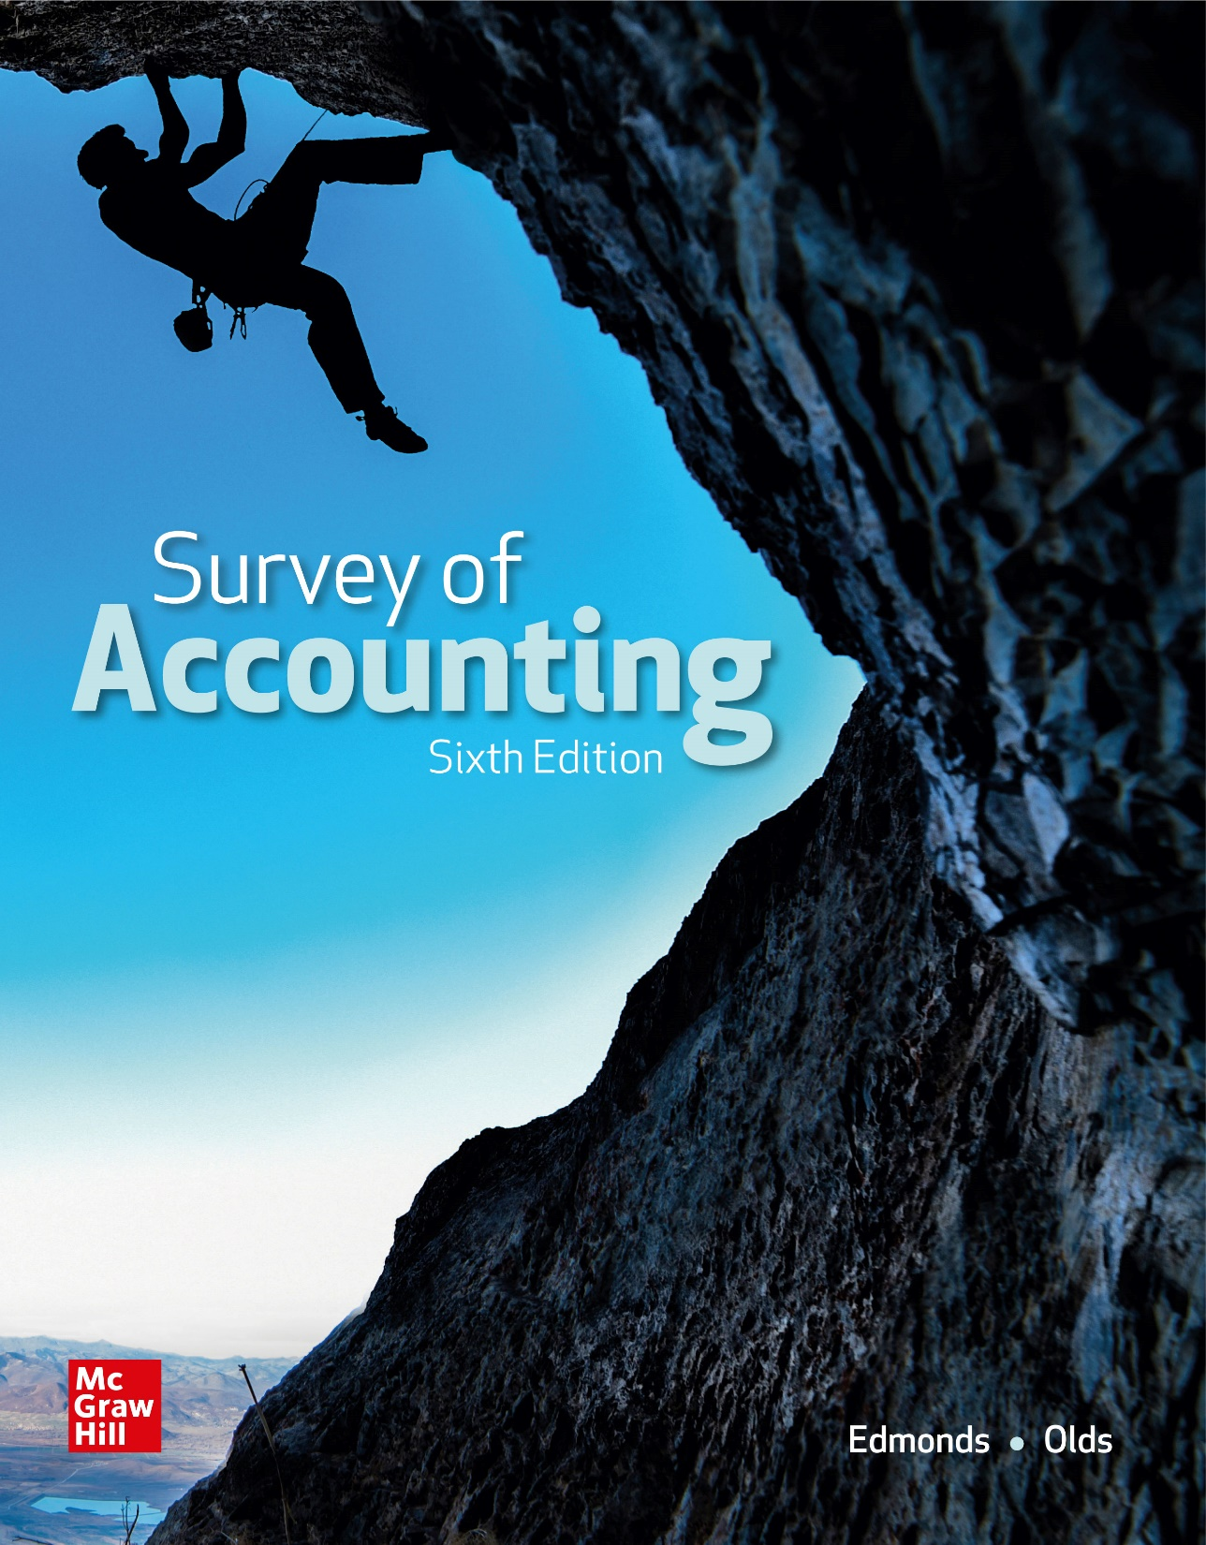
Chapter 9
Financial Statement Analysis

Slide 2
Factors in Communicating Useful Information
The primary objective of accounting is to provide information useful for decision making. To provide information that supports this objective, accountants must consider the following:
Users of financial statement information include managers, creditors, stockholders, potential investors and regulatory agencies.
The information needs of users depend upon the decision at hand.
A variety of analysis techniques have been developed due to diversity of users, their differing levels of knowledge and varying information needs.

Slide 3
LO 9-1:
Differentiate between horizontal and vertical analysis.

Slide 4
Methods of Analysis
Horizontal analysis
Absolute amounts
Percentage analysis
Vertical analysis
Ratio analysis

Slide 5
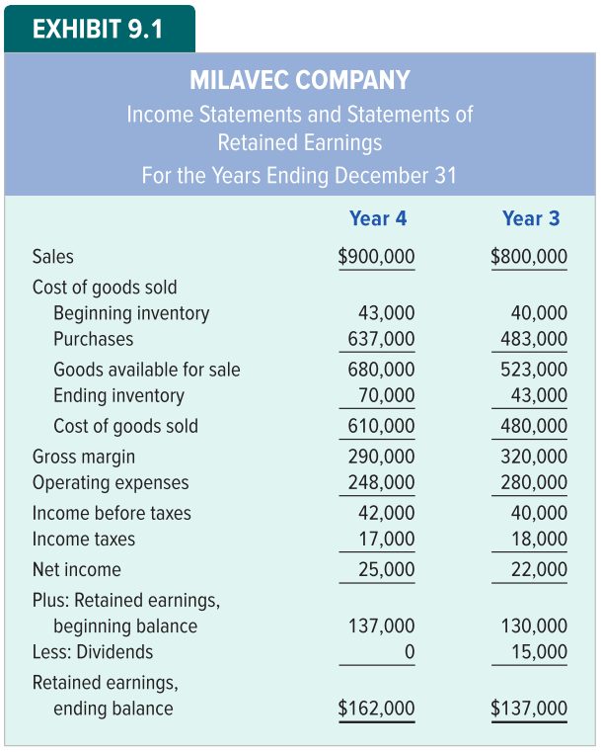
Milavec Company Financial Statements

Slide 6
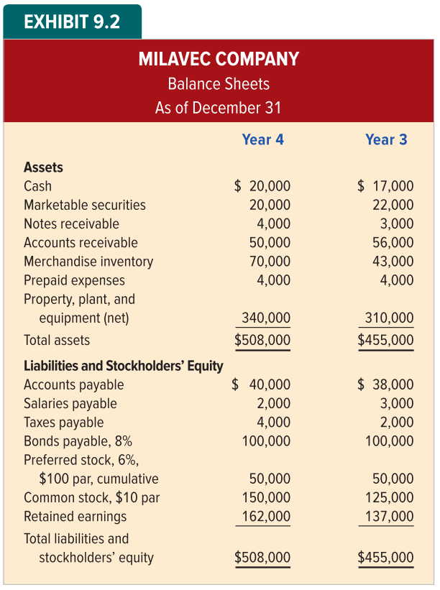
Milavec Company Financial Statements Continued

Slide 7
Horizontal Analysis
Horizontal analysis, also called trend analysis, refers to studying the behavior of individual financial statement items over several accounting periods.
The analysis of a given item may focus on trends in the absolute dollar amount of the item or trends in percentages.

Slide 8
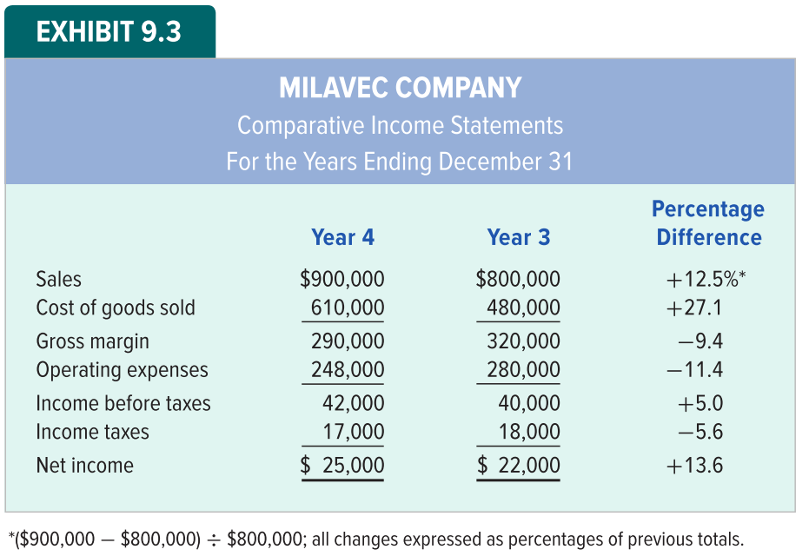
Milavec Company Horizontal Analysis

Slide 9
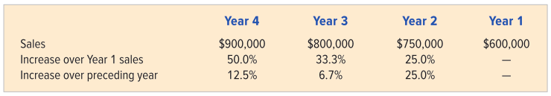
Percentage Analysis
When comparing more than two periods, analysts use either (1) choosing one base year from which to calculate all increases or decreases or (2) calculating each period’s percentage change from the preceding figure.

Slide 10
Vertical Analysis
Vertical analysis uses percentages to compare individual components of financial statements to a key statement figure.
Horizontal analysis compares items over many time periods; vertical analysis compares many items within the same time period
A common-size financial statement is a vertical analysis in which each financial statement item is expressed as a percentage.

Slide 11
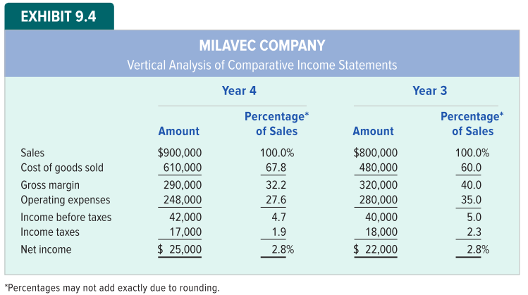
Vertical Analysis of Income Statement
Vertical analysis of an income statement (also called a common size income statement) involves converting each income statement component to a percentage of sales.

Slide 12
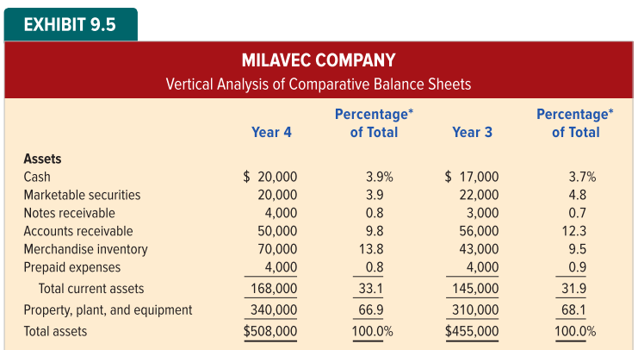
Vertical Analysis of Balance Sheet
Vertical analysis of the balance sheet involves converting each balance sheet component to a percentage of total assets.

Slide 13
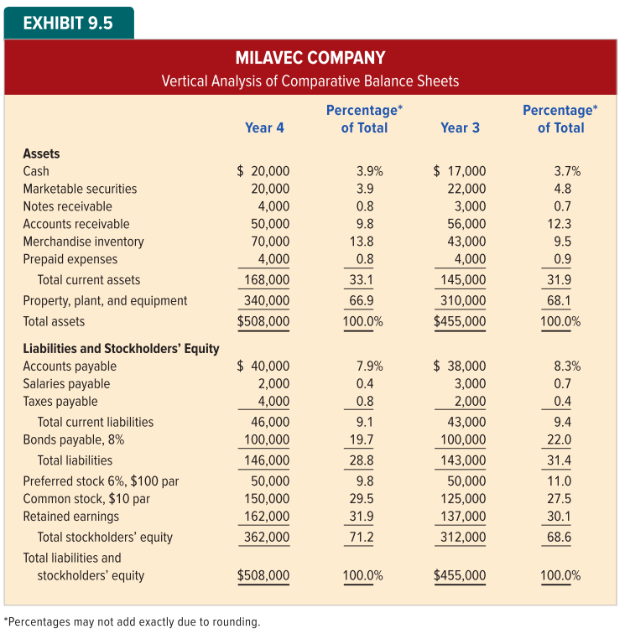
Vertical Analysis of Balance Sheet
Vertical analysis of the balance sheet involves converting each balance sheet component to a percentage of total assets.

Slide 14
Objectives of Ratio Analysis
Ratio analysis involves studying various relationships between different items reported in a set of financial statements.
Various users approach financial statement analysis with many different objectives.
Creditors are interested in whether a company can repay its debts on time
Creditors and stockholders care how the company is financed.
Past earnings performance is analyzed

Slide 15
LO 9-2:
Calculate ratios for assessing a company’s liquidity.

Slide 16
Liquidity Ratios
Liquidity ratios indicate a company’s ability to pay short-term debts. They focus on current assets and current liabilities.
Working Capital
Current Ratio
Quick Ratio
Accounts Receivable Ratios
Inventory Ratios

Slide 17
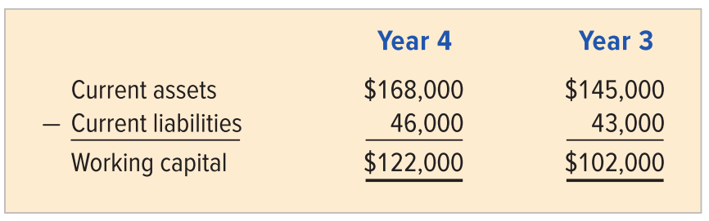
Working Capital
Working capital is current assets minus current liabilities. Working capital measures the funds a company will have available for operations.

Slide 18

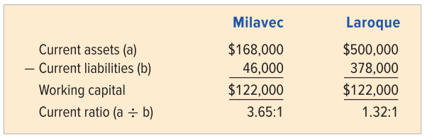
Current Ratio
The current ratio, also called the working capital ratio, expresses the relationship between current assets and current liabilities as a ratio.

Slide 19

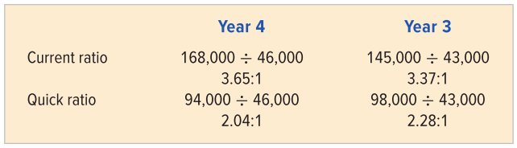
Quick Ratio
The quick ratio, also called the acid-test ratio, measures a company’s immediate debt-paying ability. Only cash, receivables and marketable securities are included in the numerator.

Slide 20


Accounts Receivable Ratios
Companies want to collect receivables as quickly as possible without losing customers. Two relationships are often examined to assess a company’s collection record.

Slide 21
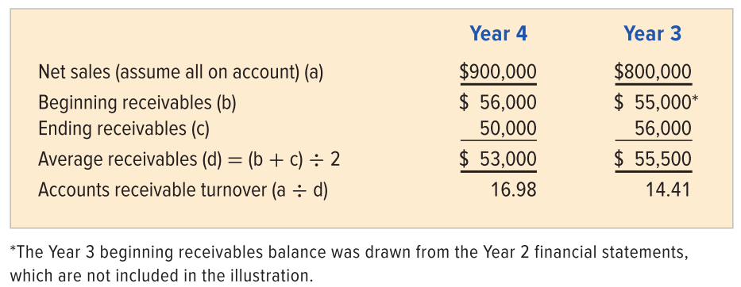
Accounts Receivable Turnover

Slide 22


Inventory Ratios
A fine line exists between having too much and too little inventory in stock. To help analyze how efficiently a company manages inventory, we use two ratios similar to those used in analyzing accounts receivable.

Slide 23
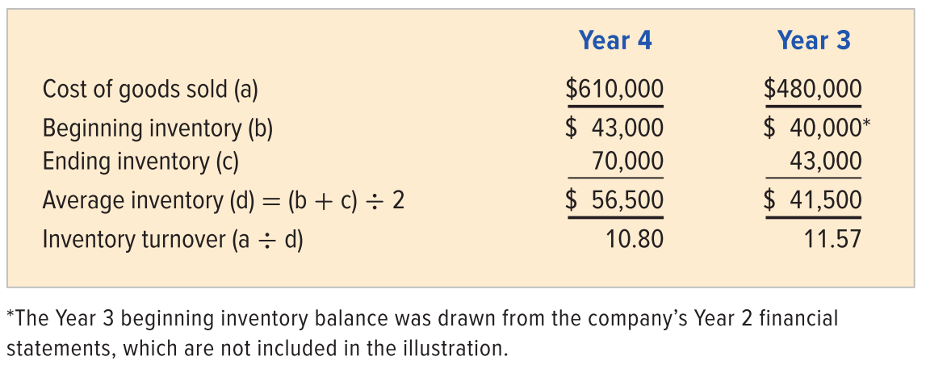
Inventory Turnover

Slide 24
LO 9-3:
Calculate ratios for assessing a company’s solvency.

Slide 25
Solvency Ratios
Solvency ratios are used to analyze a company’s long-term debt-paying ability and its financing structure.
Creditors are concerned with a company’s ability to satisfy outstanding obligations.
Stockholders are concerned about a company’s solvency
If a company is unable to pay its debts, the owners could lose their investment.

Slide 26
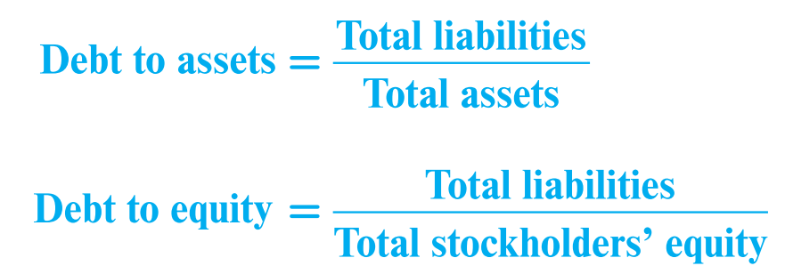
Debt Ratios
Debt-to-assets ratio measures the percentage of a company’s assets that are financed by debt.
Debt-to-equity ratio compares creditor financing to owner financing.

Slide 27
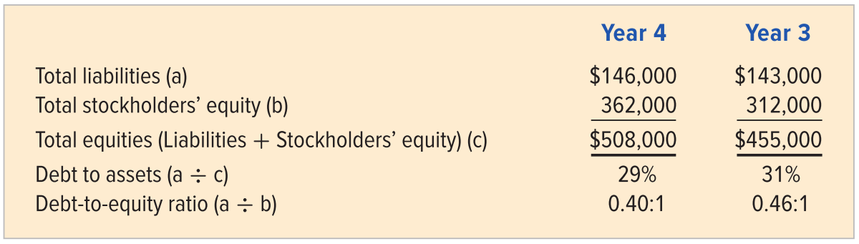
Debt to Assets and Debt to Equity Ratios

Slide 28

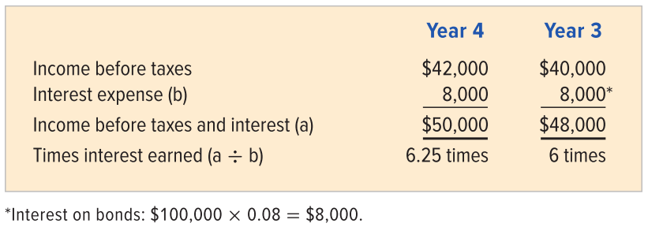
Number of Times Interest is Earned
This ratio measures the burden a company’s interest payments represent. Users often consider the number of times interest is earned along with the debt ratios when evaluating financial risk.

Slide 29

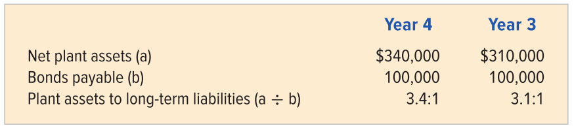
Plant Assets to Long-Term Liabilities
Companies often pledge plant assets as collateral for long-term liabilities. The plant assets to long-term liabilities ratio shows the amount of assets per each dollar of long-term debt.

Slide 30
LO 9-4:
Calculate ratios for assessing company management’s effectiveness.

Slide 31
Measures of Profitability
Profitability refers to a company’s ability to generate earnings. Both management and external users employ profitability ratios to assess a company’s success in generating profits and how these profits are used to reward investors.

Slide 32

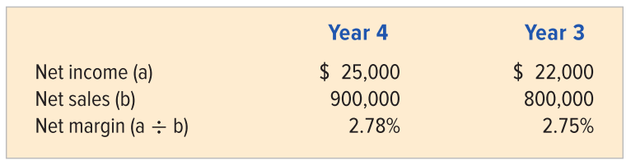
Net Margin (or Return on Sales)
Net margin, sometimes called operating margin, profit margin, or the return-on-sales ratio, describes the percentage of each sales dollar remaining after subtracting other expenses, as well as cost of goods sold.

Slide 33

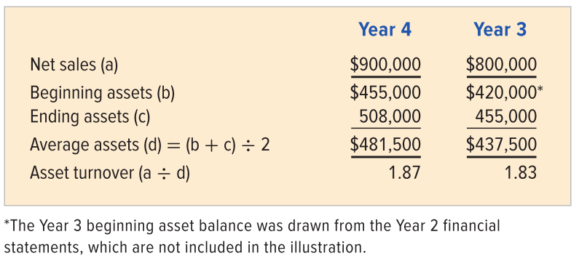
Asset Turnover Ratio
The asset turnover ratio (sometimes called turnover-of-assets ratio) measures how many sales dollars were generated for each dollar of assets invested.

Slide 34

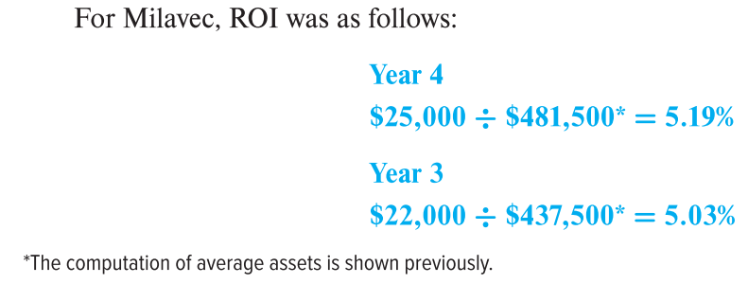
Return on Investment
Return on investment (ROI), also called return on assets or earning power, is the ratio of wealth generated (net income) to the amount invested (average total assets) to generate the wealth.

Slide 35

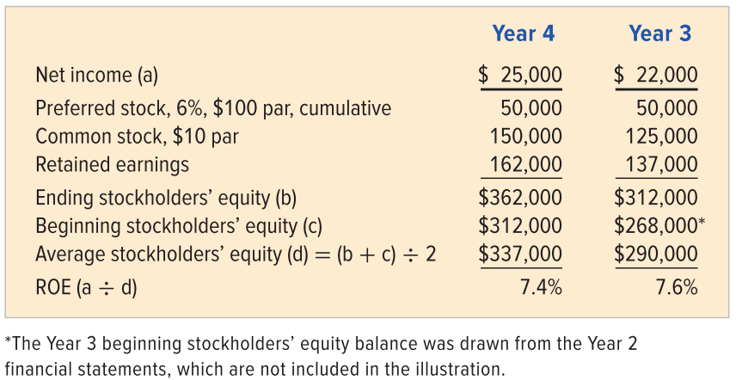
Return on Equity
Return on equity (ROE) is often used to measure the profitability of the stockholders’ investment.

Slide 36
LO 9-5:
Calculate ratios for assessing a company’s position in the stock market.

Slide 37
Stock Market Ratios
Existing and potential investors in a company’s stock use many common ratios to analyze and compare the earnings and dividends of different-sized companies in different industries.
Purchasers of stock can profit in two ways: through receiving dividends and through increases in stock value.

Slide 38


Earnings per Share
Perhaps the most frequently quoted measure of earnings performance is earnings per share (EPS).
Milavec’s Year 4 EPS is calculated as follows:

Slide 39


Book Value
Book value per share is another frequently quoted measure of a share of stock.
Milavec’s book value per share for Year 3 is calculated as follows:

Slide 40

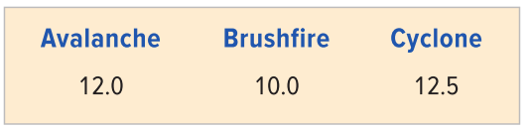
Price-Earnings Ratio
The price-earnings (P/E) ratio compares the earnings per share of a company to the market price for a share of the company’s stock.
The P/E ratios for the three companies are as follows:

Slide 41

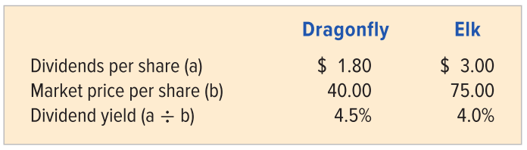
Dividend Yield
Dividend yield measures dividends received as a percentage of a stock’s market price.
The information for calculating dividend yield follows:

Slide 42
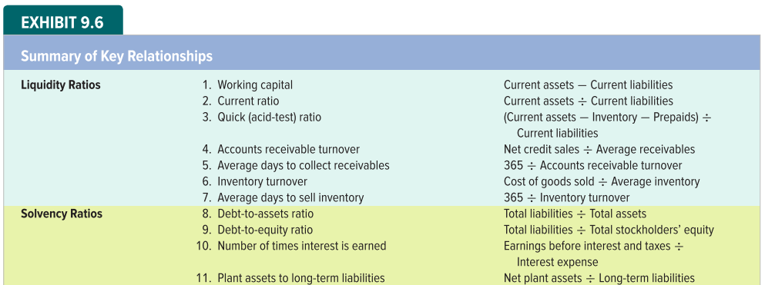
Summary of Key Relationships

Slide 43
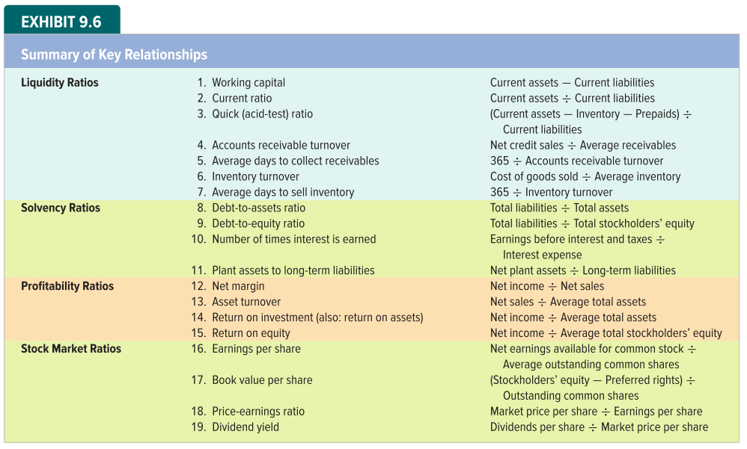
Summary of Key Relationships

Slide 44
Limitations of Financial Statement Analysis
External users can rely on financial statement analysis only as a general guide to the potential of a business.
Different industries may be affected by unique social policies, special accounting procedures, or other individual industry attributes.
When comparing firms, analysts must be alert to changes in general economic trends from year to year.
Financial statement analysis is only as reliable as the data on which it is based.

Slide 45
End of Chapter 9

